Slide 1

Honeypot XU Xuehan 1155130747

Slide 2
Introduction
the network defence technologies can be divided into passive defence and active defence. Passive defence method sets corresponding defence strategies against common attack methods.
Active defence methods make accurate predictions promptly and establish a flexible defence system before the intrusion could affect the system.

Slide 3
Passive defense
Take the firewall as a passive defense example.
A firewall is usually deployed at the boundary of a local area network and is the bridge between the internal network and the external network. A firewall can be a simple packet filter or it can also contain some other useful features such as logging, auditing and intrusion detection. A firewall works on mutiple layers of the protocol stack.

Slide 4
packet filtering - act on the internet layer, determinate whether to allow the data packet to pass according to the header
application proxy - work in the application layer, through programming different application agents, achieve the detection and analysis of application layer data.
stateful inspection – deal with the whole connection judge the rule table and connection status table.
complete content inspection - handle the content of application layer protocols to prevent hybrid security threats.

Slide 5
iptables is a tool for managing kernel packet filtering
Netfilter is a Linux 2.4 kernel firewall framework proposed by Rusty Russell.

Slide 6
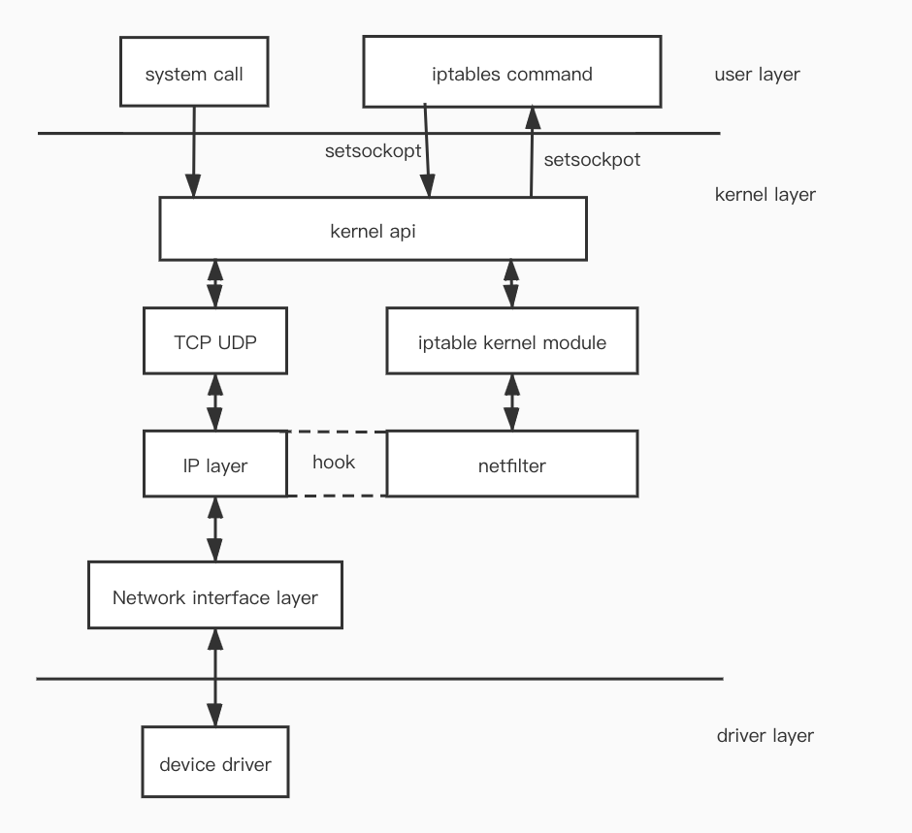

Slide 7
Active defense
A honeypot is an information system resource whose value lies in unauthorized or illicit use of that resources. A honeypot is a computer system that runs on the Internet and is specifically designed to attract and deceive people who try to illegally break into the valuable computer system.

Slide 8
History of honeypot
Fred Cohen's Deception ToolKit was the first honeypot released in public in 1998.
At the beginning of 21th century, honeypots were able to capture and analyze worms.
In 2004, virtual honeypots came out which allow multiple honeypots to run on a single server.

Slide 9
The main principles of honeypot include the following aspects:
cyber fraud. Make intruders believe that there are valuable and available vulnerables.
Data capture. It is generally implemented in three layers.

Slide 10
Data analysis. Data analysis integrates and mines various attack info, analyzes hacker tools, strategies, and motives, provides real-time info for researchers.
Data control. Used to ensure the safety of the honeypot. Control the network connection going out of the honeypot so that it will not become a springboard for intruders and endanger other systems.

Slide 11
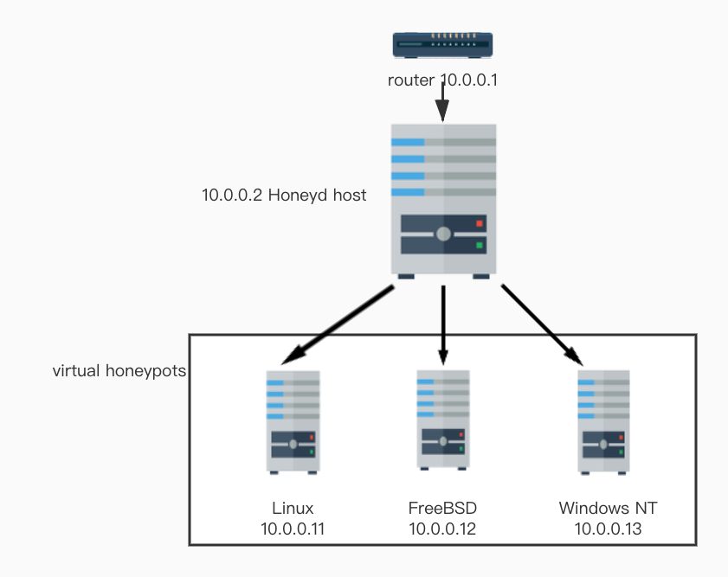
Honeyd
http://www.honeyd.org/
Honeyd is a virtual honeypot framework for Linux / unix developed by security researcher Niels Provos.
It uses one single physical
host to create multiple
virtual hosts.

Slide 12
Honeyd structure is composed of several parts: a configuration database, a central packet distributor, protocol processor, personalization engine and random routing components

Slide 13
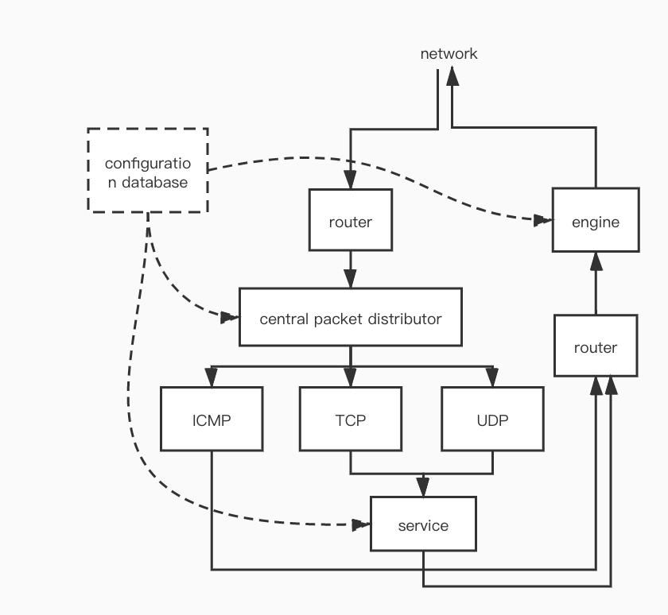

Slide 14
Honeyd structure also supports the redirection of the connection. The redirection can be static or dependent on the connection quad. It allows us to forward a service connection request on a virtual honeypot to a service running on a real server.

Slide 15
Implementation of Honeyd
Honeyd relies on Libevent( event processing API), Libdnet( packet construction and sending library) and Libpcap( packet capture library).
We need install arpd to ensure that the honeyd host responds to the ARP request of the honeypot ip we configured.

Slide 16
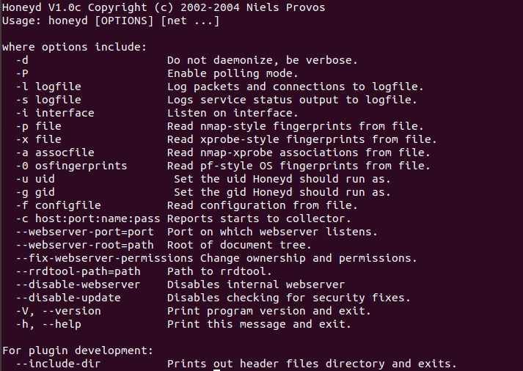
sudo ./arpd 172.31.0.0/16
./honeyd –f honeyd2.conf 172.31.0.0-172.31.1.255

Slide 17
Honeyd provides a simulation service script to simulate the application layer protocol.
You can find scripts at /scripts

Slide 18
Comments and future
It can complete the simulation of the network topology and resist fingerprint detection.
The use of honeyd is very convenient and widely used.

Slide 19
The evolution of honeypot will continue
Integration of AI and honeypots
Integration of blockchain technology and honeypots
Integration of genetic evolution calculation and honeypot

Slide 20
Reference
Lance Spitzner. Honeypots: Tracking Hackers. Addison Wesley Professional. September 2002.
Laurent Oudot. Fighting Internet Worms With Honeypots.http://www.honeypots.net/
Eric Peter. A Practical Guide to Honeypots. https://www.cse.wustl.edu/~jain/cse571-09/ftp/honey/index.html. April 2018.

